Slide 1
District 7610 Rotary Global Grant Scholarships
Selection Year 2023-24
Scholarship Year 2024-25

Slide 2
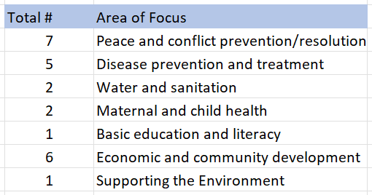
RGGS: Over a Decade of Impact
10 years, 24 scholarships awarded
$1.28M in funding for Rotary Global Scholars
Supporting ALL 7 of RI’s Areas of Focus!

Slide 3
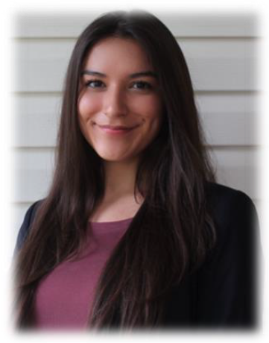
General Requirements
Rotary Global Scholars are individuals who are pursuing a career in one of the seven areas of focus. Their graduate-level educational goals should support this career interest.
Peace and Conflict Prevention/Resolution
Disease Prevention and Treatment
Water and Sanitation
Maternal and Child Health
Basic Education and Literacy
Economic and Community Development
Supporting the Environment
Minimum value is $40,000 (DDF: $20,000 + TRF: $20,000)
Scholarships may not be used for studies that are already underway.
Global grants follow a three-step application process: ①Club, ②District, ③TRF

Slide 4
Specific Eligibility Requirements
Scholars must have either a home address or a college address in your club’s service area (within D7610)
Candidate’s program of study must be at the graduate level
Scholar must be traveling abroad for study
Candidate must be admitted to program of study before TRF approval
Candidate must be proficient in the native language of the host country
Candidate may not be a Rotarian, spouse, child or grandchild of member

Slide 5
Additional Important Qualities
Possesses excellent leadership skills and potential
Has a proven record of success in his/her academic field or vocation
Demonstrated a personal commitment to community service
Has well-defined and realistic goals
Has concrete ideas as to how he/she will make advances within his/her chosen career field
Is sincere about maintaining a lifelong relationship with Rotary after the scholarship period

Slide 6
Significant Deadlines
Action | Date
Local Interviews/Selection at Club level | Late Sept / Early Oct
Clubs submit application to District Scholarship Chair | NLT 20 October 2023
District interviews all district scholarship applicants | NLT 10 November 2023
District notifies applicants: Finalist, Waitlist, Unsuccessful | NLT 20 November 2023
Finalists apply for admission | NLT 26 November 2023
Initiate TRF online Global Scholarship Grant Application(s) | NLT 20 January 2024
Obtain partner district(s) in the country(ies) of study. | NLT 01 February 2024
Submit application for final TRF approval. | NLT 20 February 2024
Anticipated date for final confirmation of award(s) by TRF | 15 March 2024
Scholar obtain required travel documents (visa(s), etc.) | NLT 01 June 2024
Arrange for transportation to country(ies) of study | NLT 1 July 2024

Slide 7
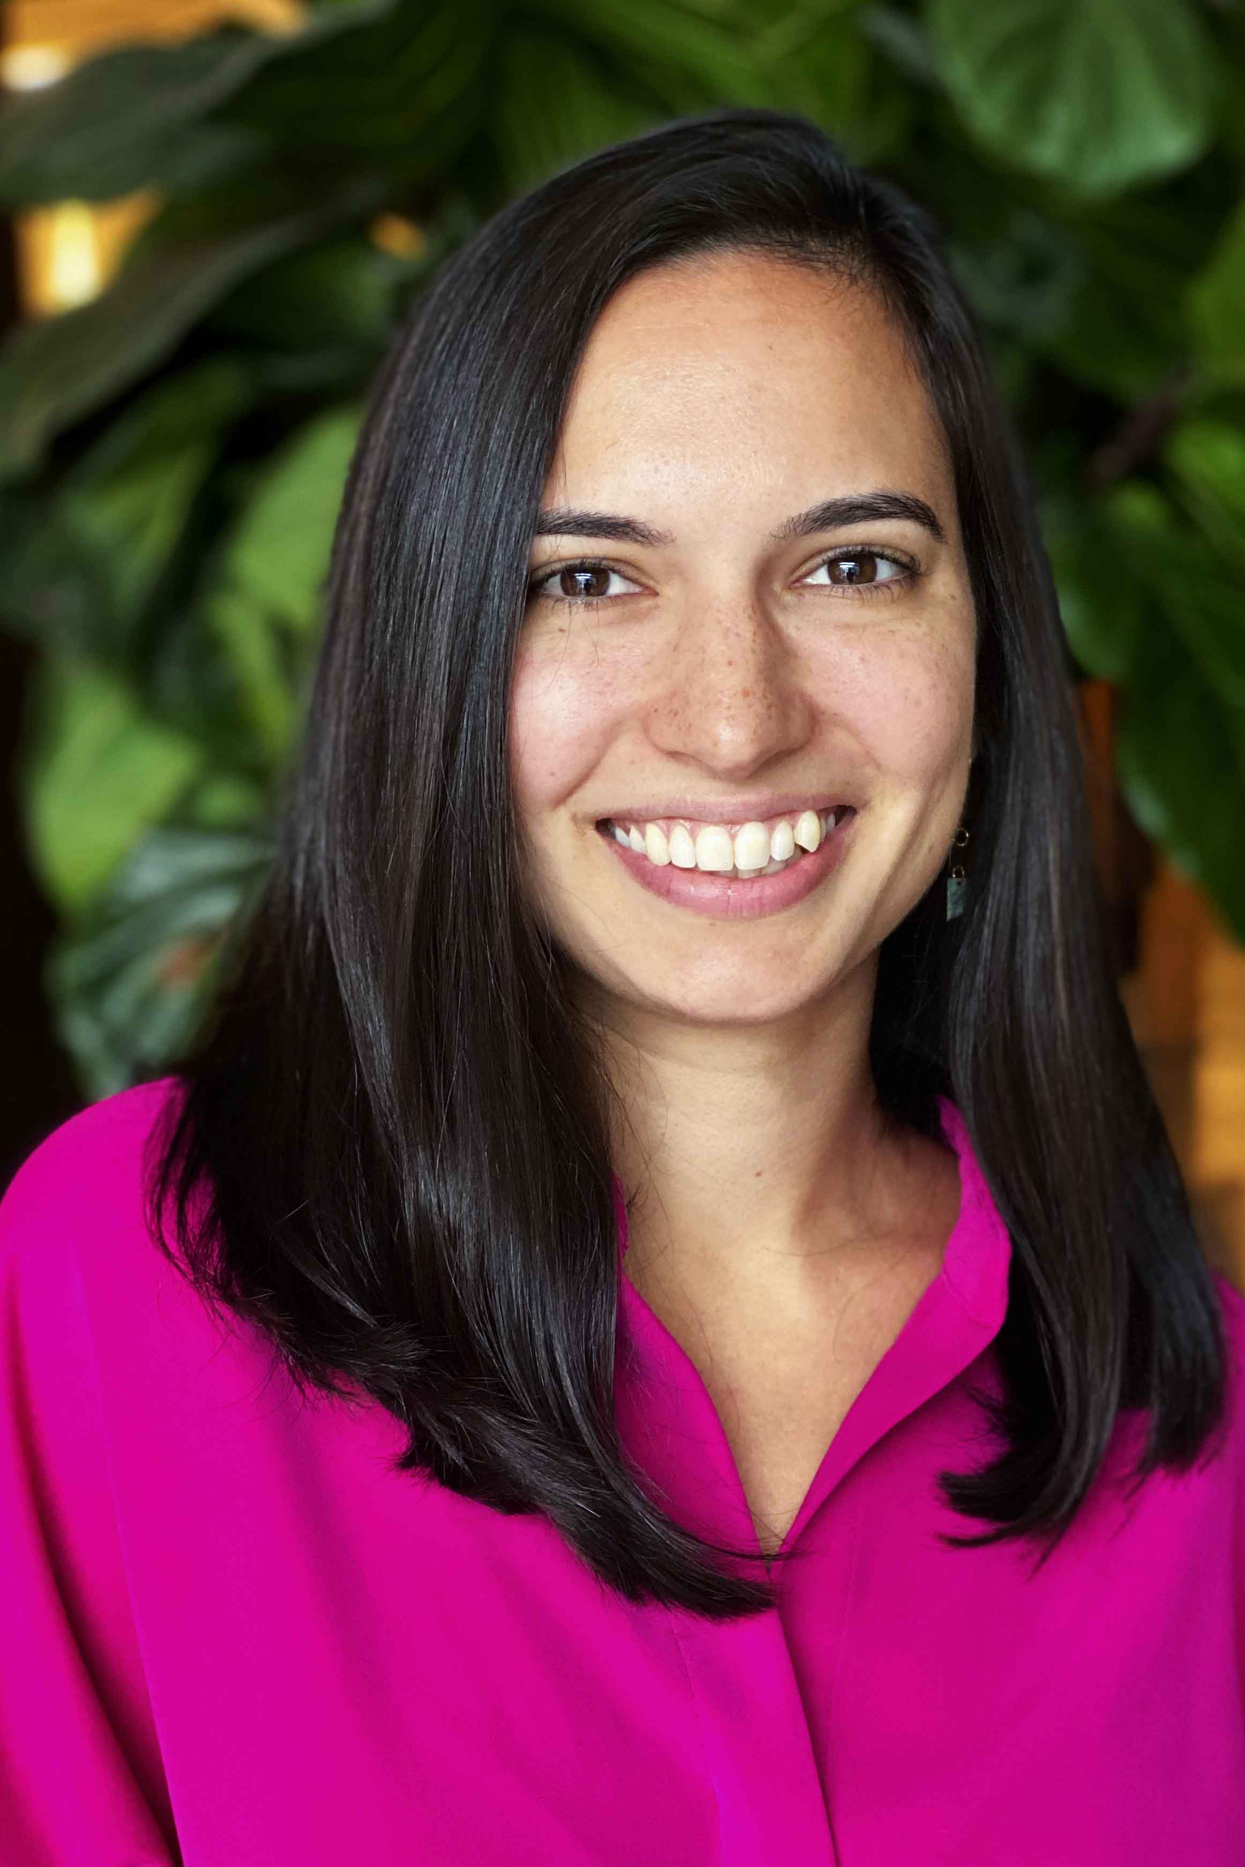
Next Steps for each Applicant in D7610
Complete the online application form
Access the District 7610 Home Page, then
Scroll down to the Rotary Foundation Section
Then click “Scholarship Grants” link on the right side
…which will lead to the following page:

Slide 8
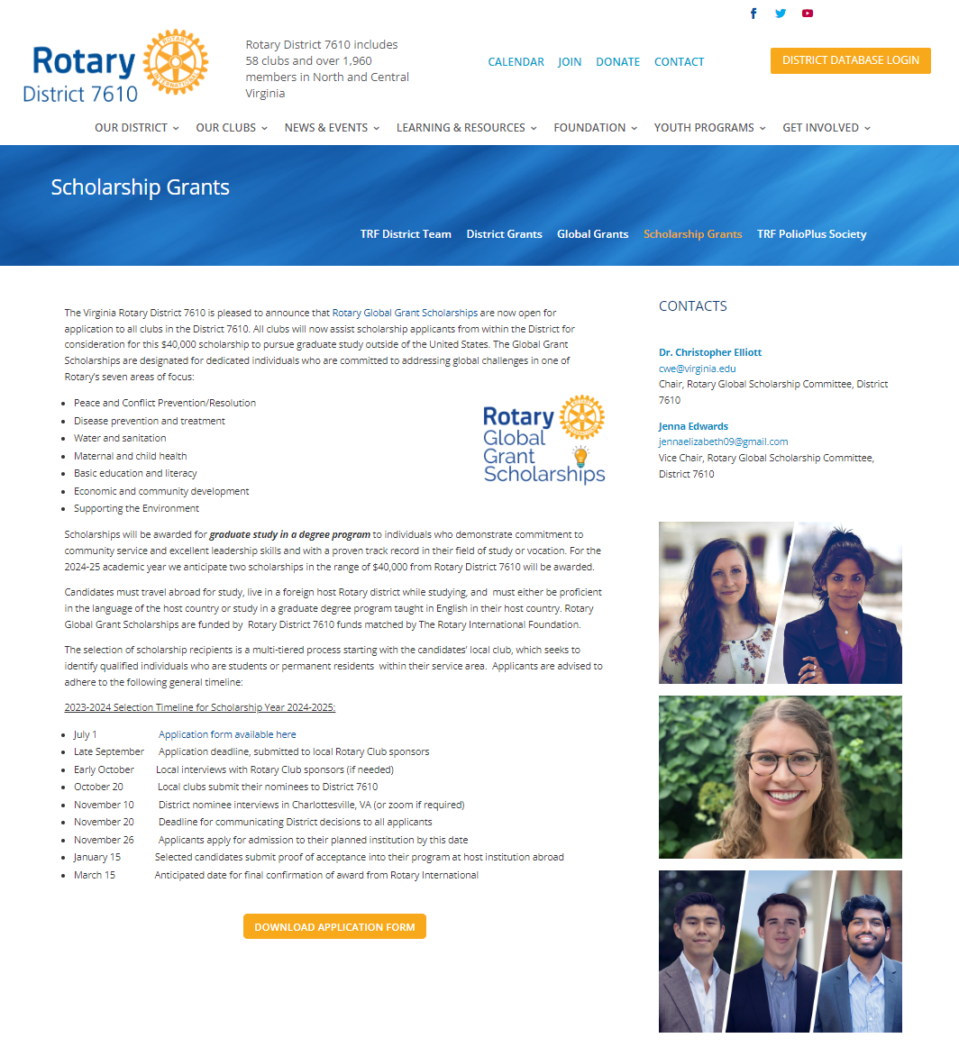
Scholarship Grants Webpage
Download application here

Slide 9
Key Parts of Application
AREA OF FOCUS AND GOALS
Explain how your program of study relates to your selected area(s) of focus and goals.
Provide a Description of the program coursework, such as a list of the classes you plan to attend and any relevant links to further information about the program on the website.
What past education or experience has led to your interest in this particular program at this institution?
Sustainability AND Measurability
Describe your educational and professional goals, including your career plans, and how your chosen program of study will help to advance these goals.
What community need will your work address during or after completing this program?
How will your work contribute to addressing this need on a long-term basis?

Slide 10
Clarification of Responsibilities
Applicant: Completing application and ensuring it meets all requisite criteria; soliciting local club for endorsement; sending application to club; if selected as a finalist, complying with all subsequent deadlines and requirements
Club: Forwarding application to District; may provide recommendations on improving application, but this will vary according to club’s discretion
District: Processing applications; selecting candidates for interview; communicating application status at critical junctures
Global Grant Scholarship Committee Chairs (Chris Elliott and Jenna Edwards): Fielding inquiries to the extent there is no conflict of interest with ethical duties on selection committee

Slide 11
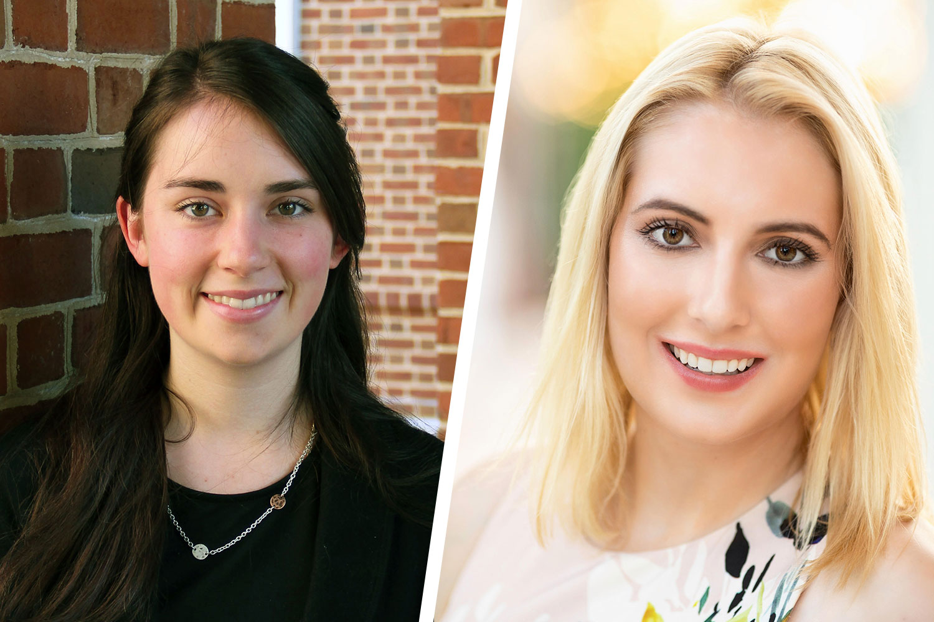
Next Steps
Assure application is complete:
1) App form, 2) resume, 3) transcript
Reach out to D7610 club for endorsement via https://rotary7610.org/club-presidents/
Your endorsing club will be responsible for forwarding your application to the District NLT than 20 October 2023
The District will communicate with you about the receipt and status of your application

Slide 12
Good luck and best wishes in your endeavors!

